Slide 1
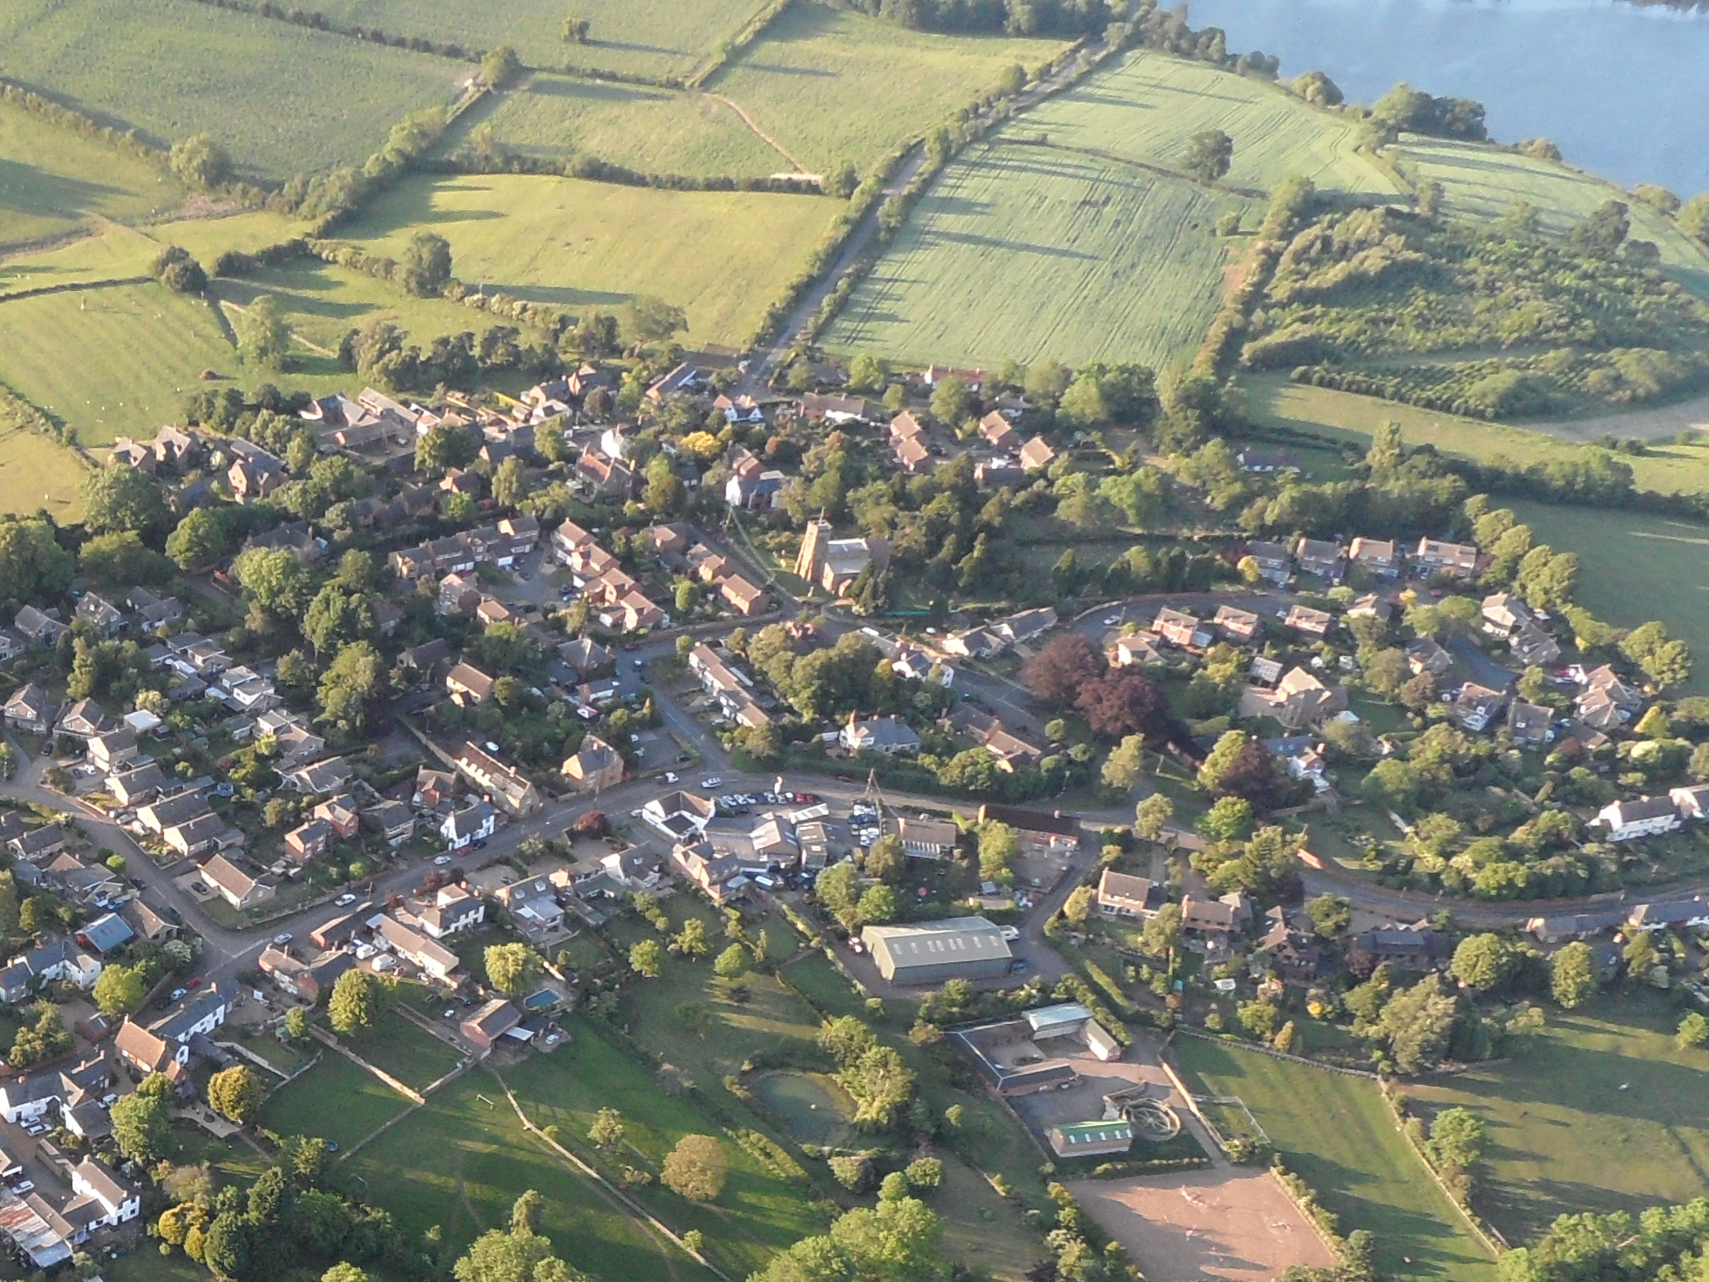
Ravensthorpe Village Design Statement Review
16th May 2015

Slide 2
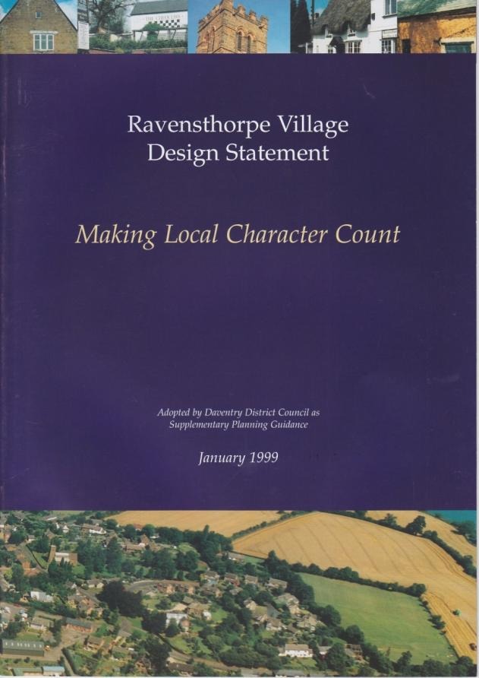
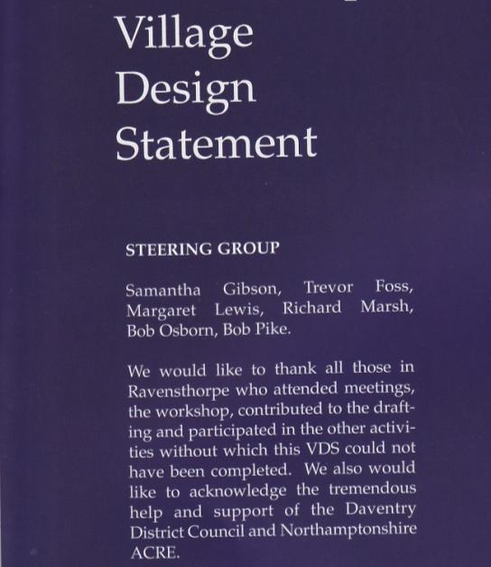
RAVENSTHORPE VILLAGE DESIGN STATEMENT
1999

Slide 3
VDS Review Group
Yvonne Childs
Mike Cobbe
Nick Ellison
Chris Freeman
Ray Gardner
Diane Hayes
Kay Lee
Margaret Lewis
Richard Marsh (Chairman)
John Mott
David Rees
Viv Rees
Ray Wadlow
Mary Worthington
Cliff Giles
Gill Douglas
Sam Gibson
Ruth Rolls
Minutes of meetings and copies of some of the working draft documents are available on the village website.
Many thanks to Viv & Dave Rees for allowing us to use their studio for meetings and for the loan of the display boards.

Slide 4
Advice from DDC
Consultation
Update facts
Link to wider planning environent
Update map
Review and illustrate views and open spaces
Reference photos to text

Slide 5
Consultation
Questionnaire to residents
  47% response rate
  96% support for VDS revision
Wider representation on review group
Draft text available on village website
This meeting

Slide 6
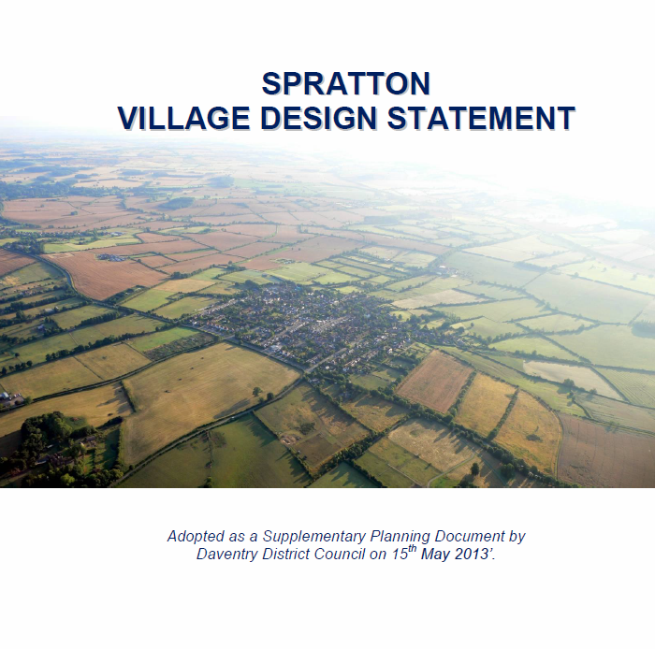

Slide 7
Update Facts
250 households
13 new houses since 1999
2 sites with planning consent for 3 houses
17 listed structures (includes cob walls)

Slide 8
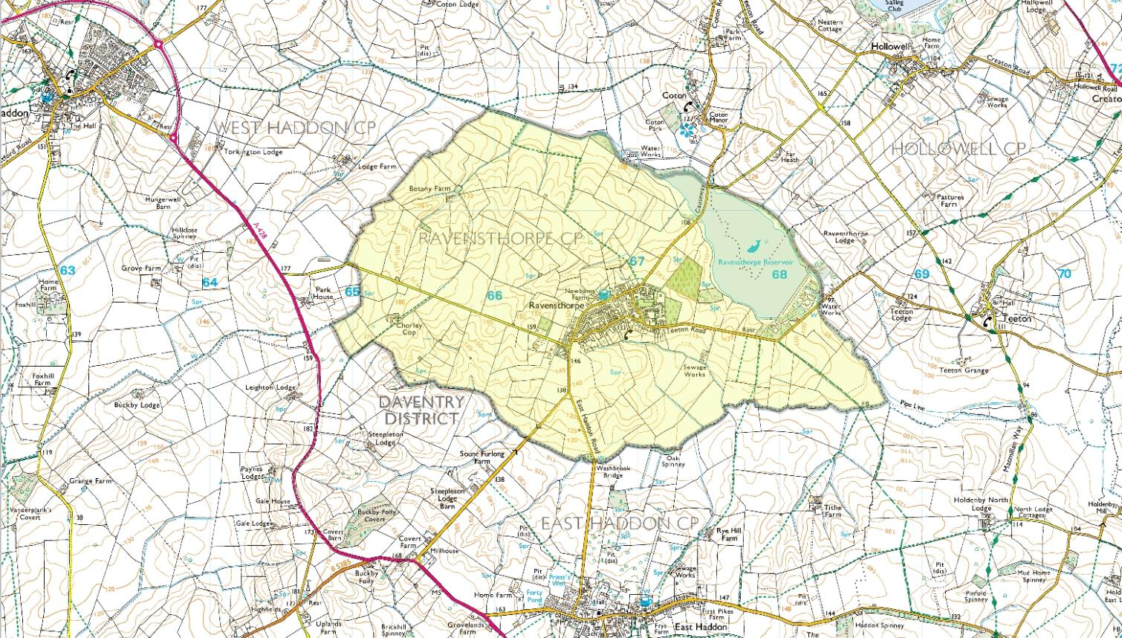
VDS Boundary

Slide 9
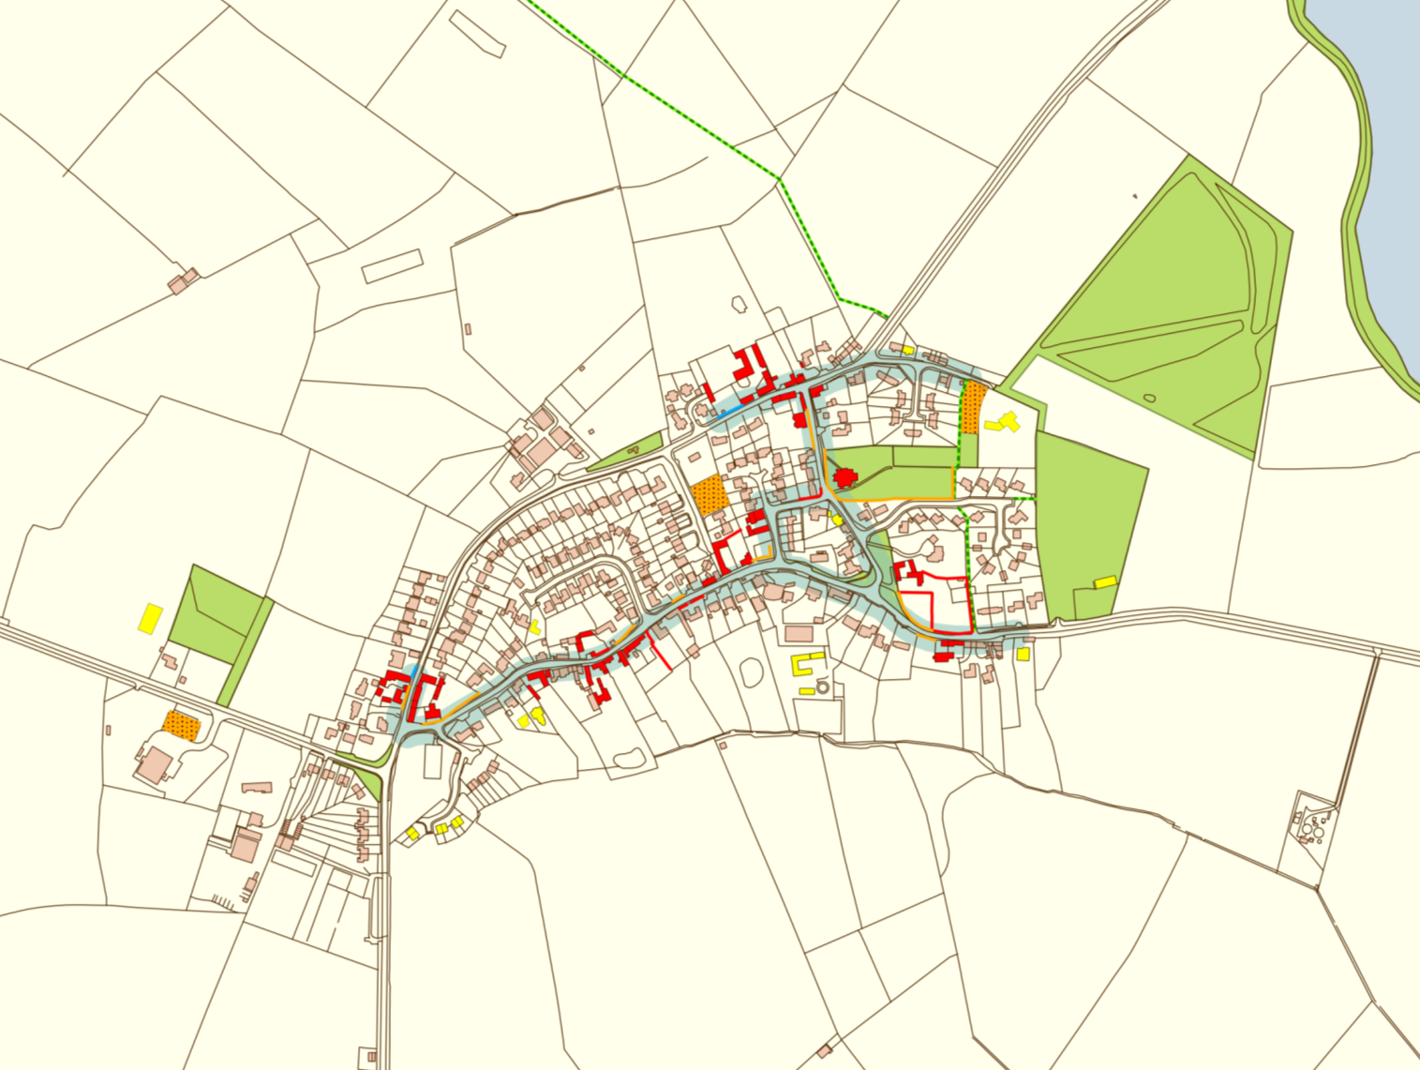
VDS Map 2015
New since 1999

Slide 10
VDS Text
Sections Rearranged
Now 8 sections
  Introduction
  Context and history
  Landscape setting
  Settlement Patterns
  Community and Commercial Facilities
  Buildings
  Highways and Infrastructure
  Environmental Sustainability

Slide 11
Village Context
Ravensthorpe is a rural village situated in northwest Northamptonshire, approximately midway between Northampton and Rugby, eight miles northeast of Daventry, and ten miles south of Market Harborough.
Population
From a peak of 620 in 1821 the village population had fallen to 315 by 1961. In 2014 Ravensthorpe had around 250 households and a population of approximately 660. At the 2011 census 19% were under 18 and 21% over 65.
Historical Notes
There is an entry for 'Ravenstorp' in the Doomsday Book of 1086 which describes a population of 3 freemen, 4 villagers and 8 smallholders. The present Church dates from 1290. The Font Bowl is older and may be from an earlier Church on the site.
Ravensthorpe retained the open field system until relatively late but enclosure in 1795 led to major changes in the landscape . In1890 Ravensthorpe Reservoir was constructed in the valley to the northeast of the village.
The second half of the twentieth century saw a fundamental change in Ravensthorpe's economy which until then had been predominantly agricultural and many changes to its building stock and local services, including the closure and demolition of the village school and the former Baptist Chapel.

Slide 12
Guidelines
Statements of fact removed
Some taken unchanged from 1999
Some from 1999 but modified
Some from Spratton VDS 2013
Some new
Some moved to more appropriate section
List of possible guidelines on display for red or green stickers

Slide 13
Views and Open Spaces
Most contentious feature of original VDS
Aim of VDS is not to identify areas for development but equally it should not inhibit development unless there are overwhelming reasons for doing so.
If Open Spaces and views are to be protected
  Need general support from residents
  Need to meet objective criteria

Slide 14
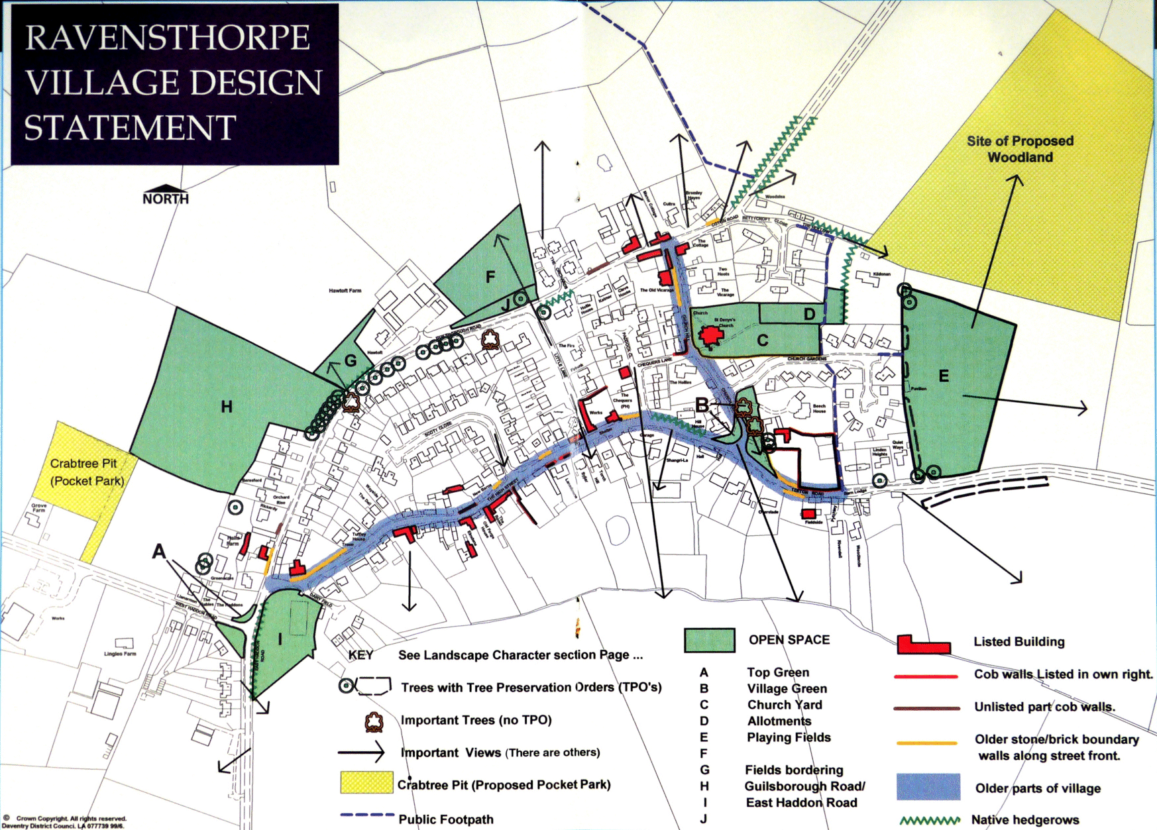
Views & Open Space 1999

Slide 15
Open Spaces
1999 VDS combined public open spaces and privately owned open spaces
Need to distinguish between the two
May be desirable to preserve additional open space but needs support
New category of Local Green Space might be applied for

Slide 16
Local Green Space Criteria
Close to community
Demonstrably special
  Beauty
    Link other open spaces and allow valued views
  Historic Significance
  Recreational Value
  Tranquillity
  Richness of wildlife

Slide 17
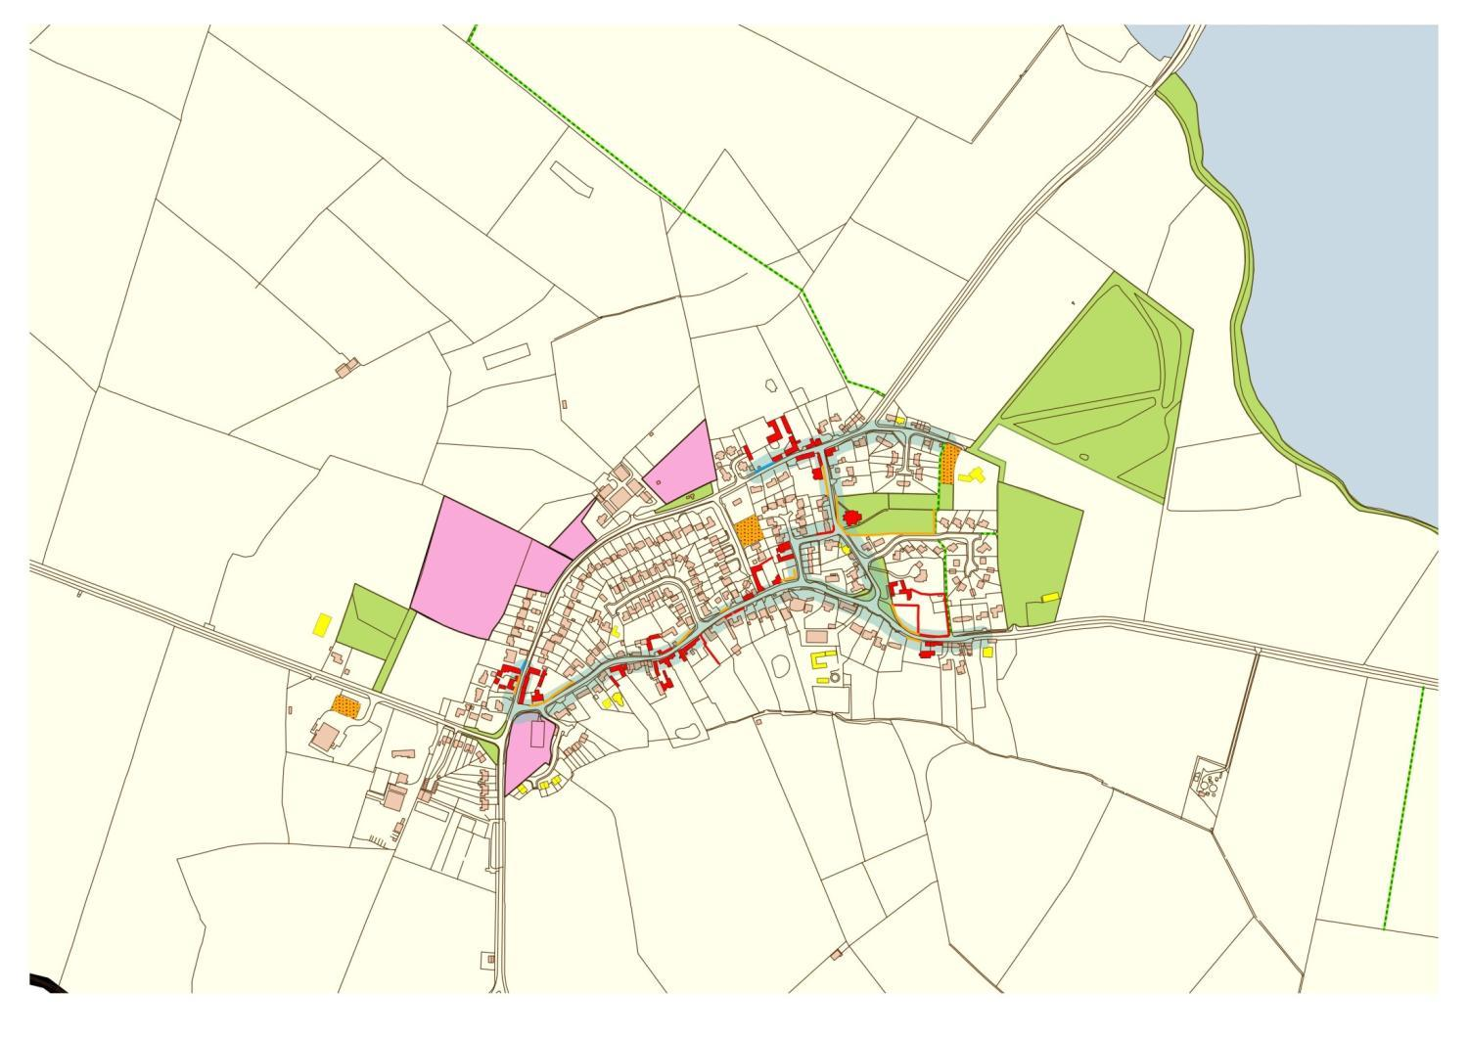
Open Spaces on 1999 VDS map

Slide 18
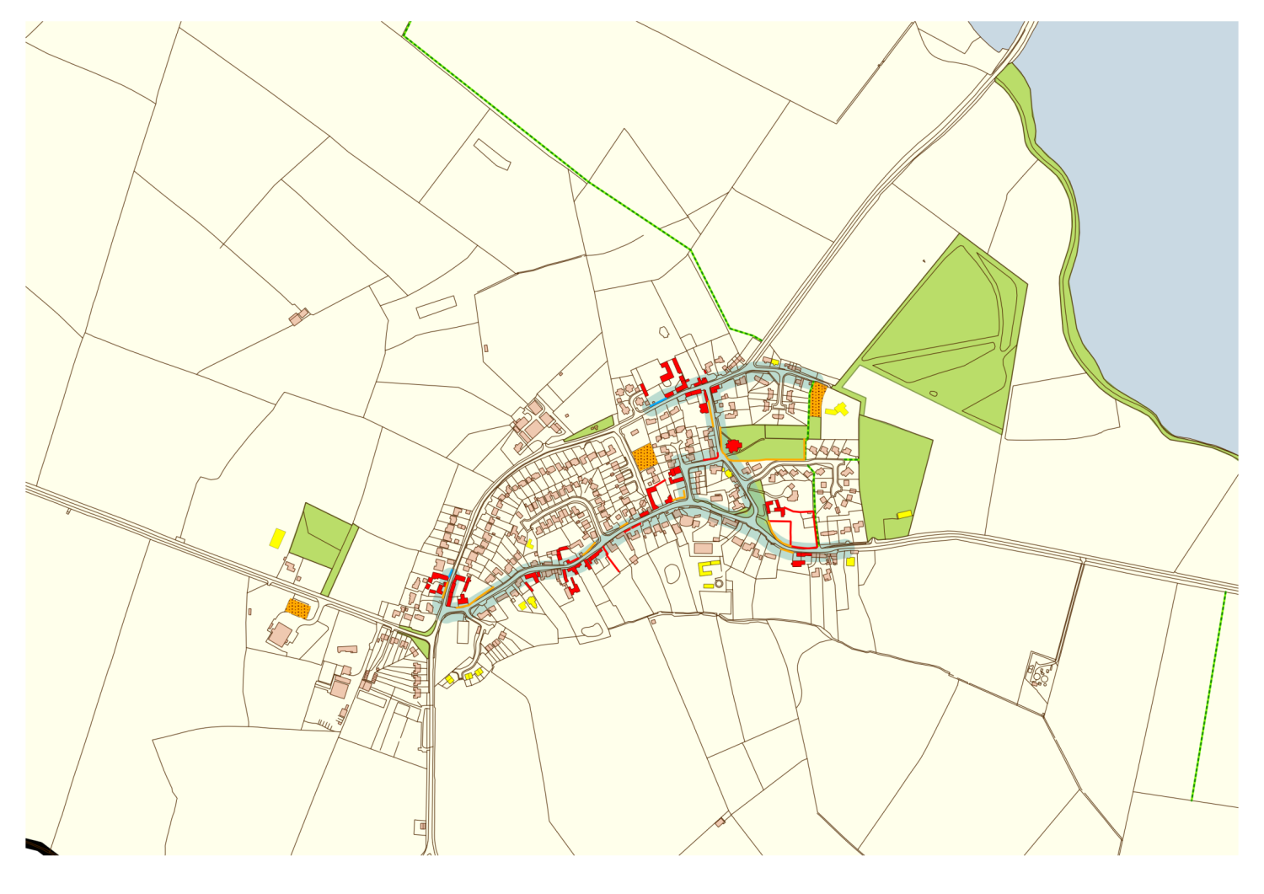
Existing Public Open Space

Slide 19
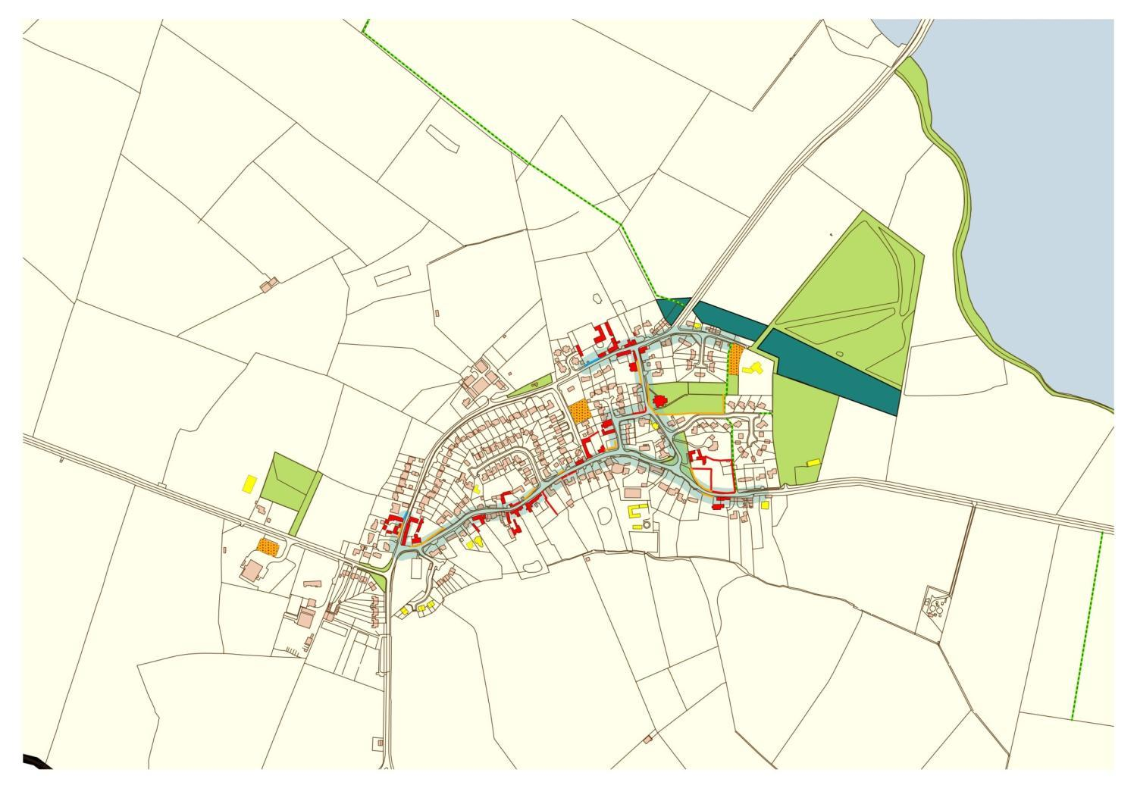
Possible Open Space to protect views of resevoir

Slide 20
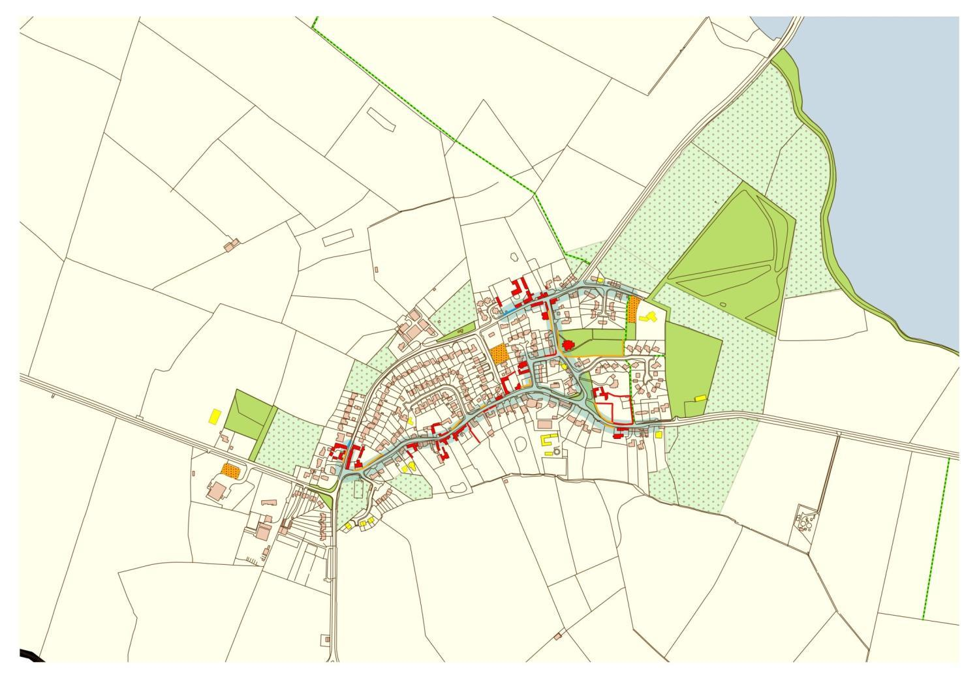

Slide 21
Views
Sense of countryside proximity important
Views from village boundaries
‘Glimpses’ through gaps between buildings
Need justification and photos to support

Slide 22
Views & Open Space 1999

Slide 23
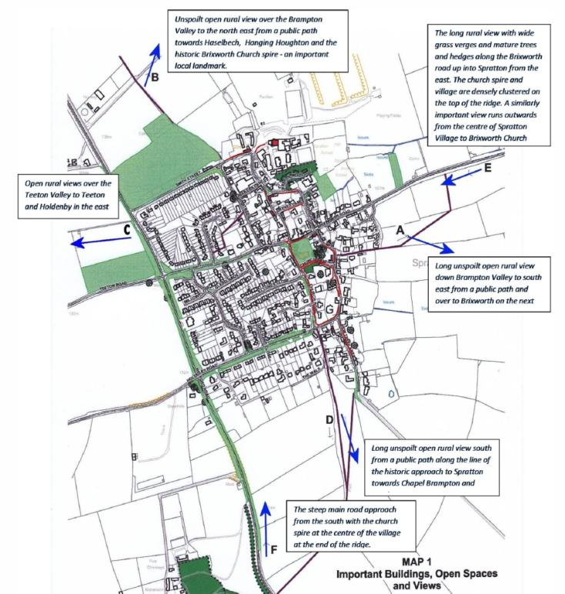
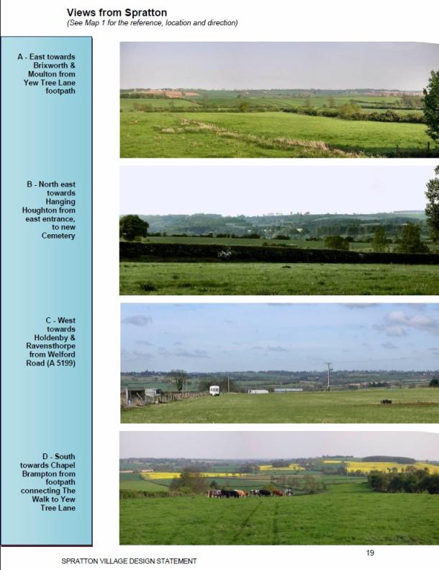

Slide 24
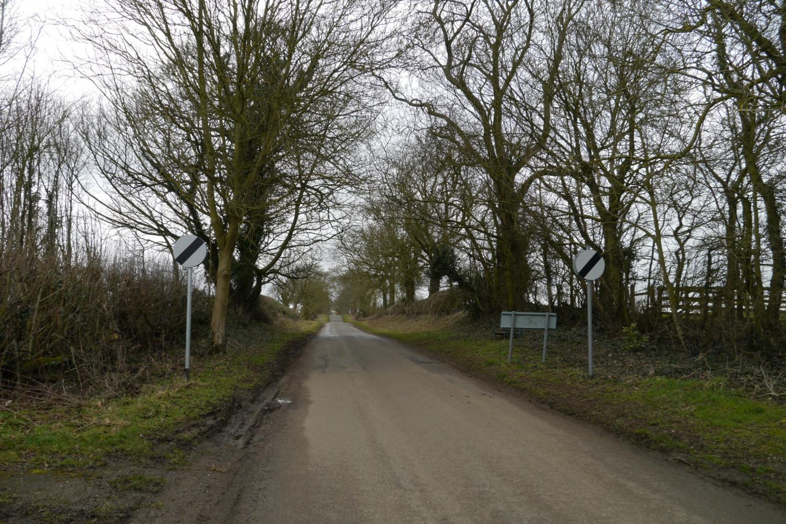
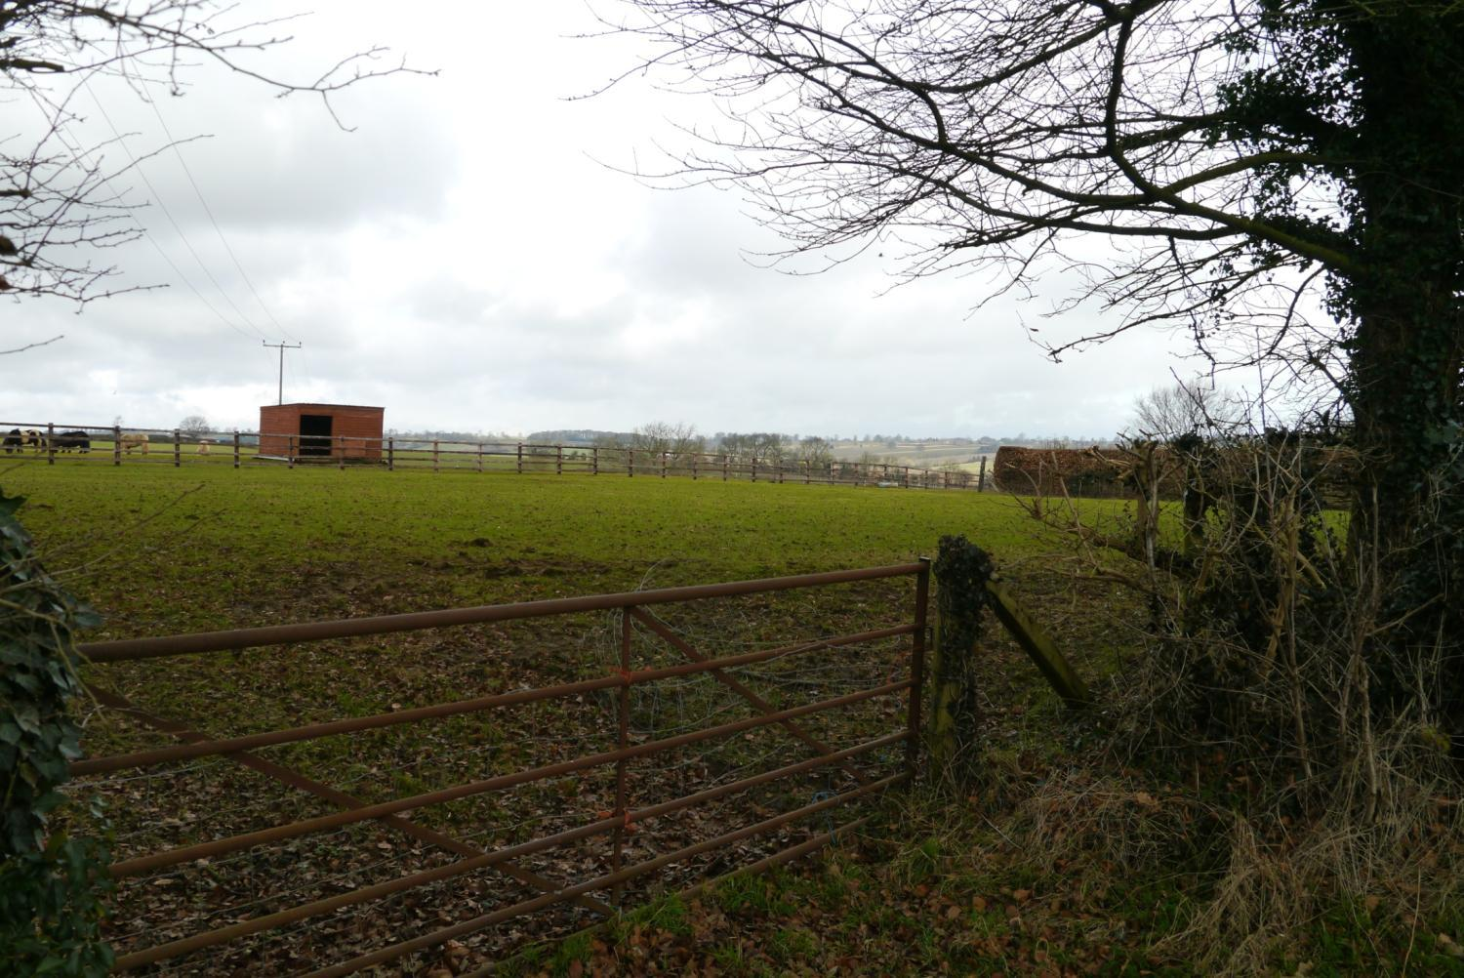
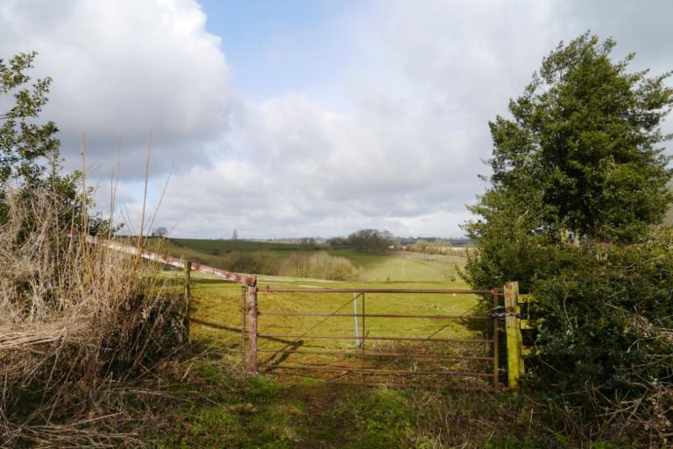
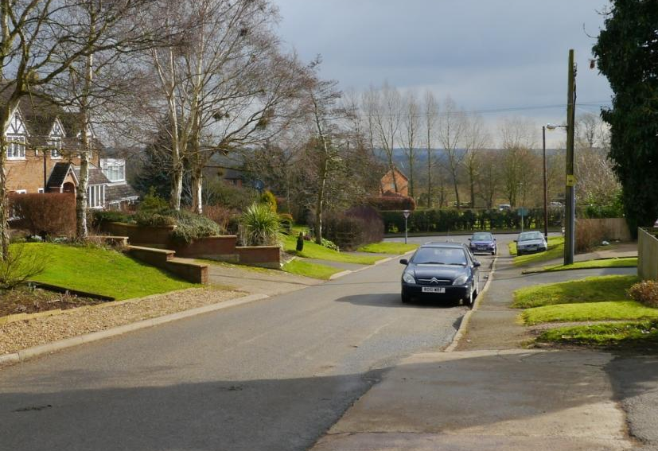

Slide 25
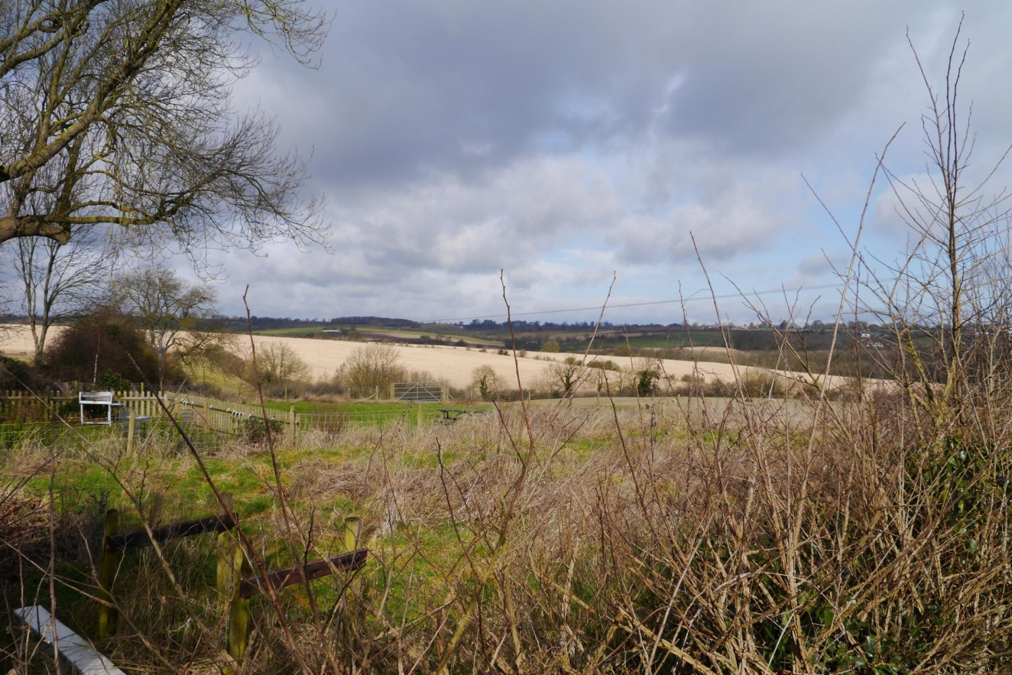

Slide 26
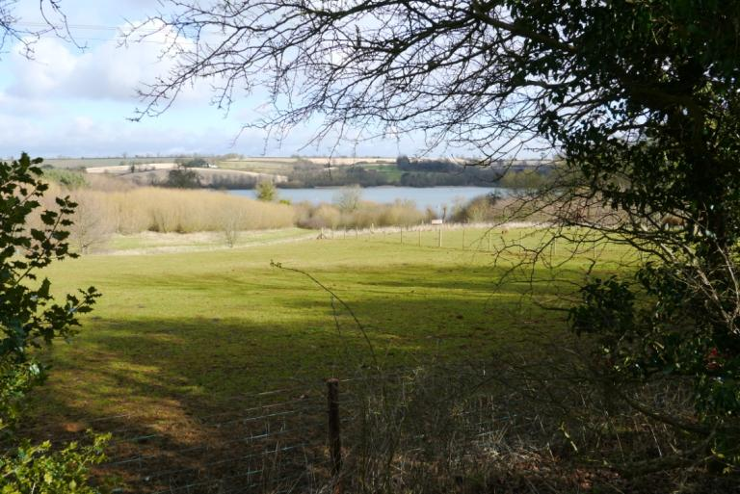
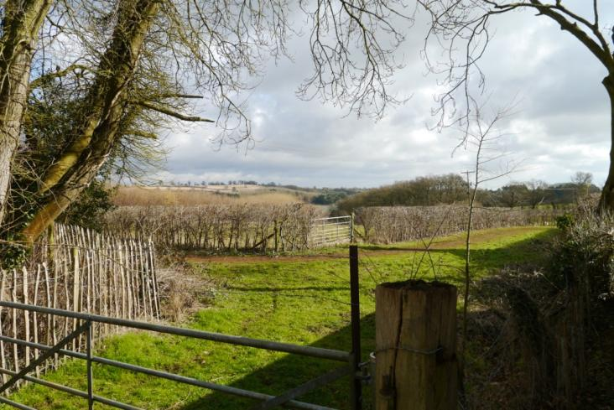
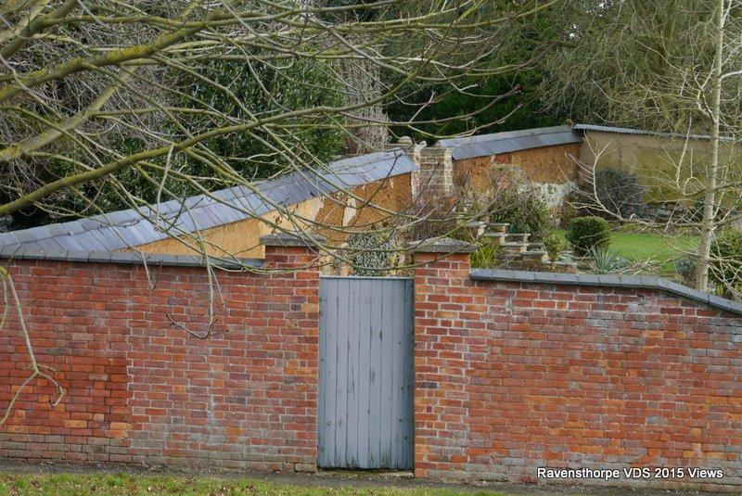

Slide 27
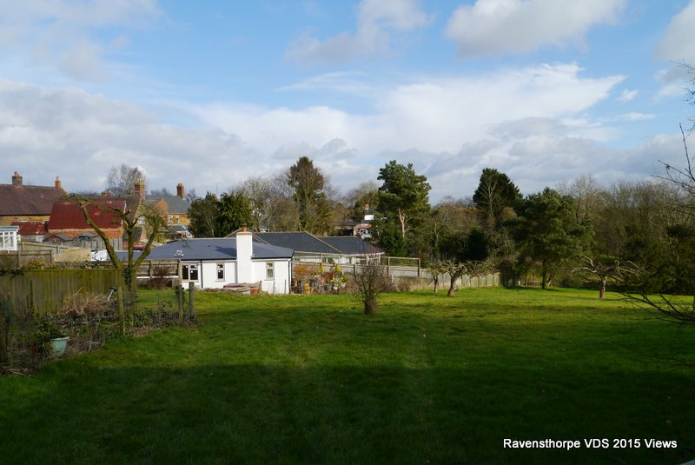
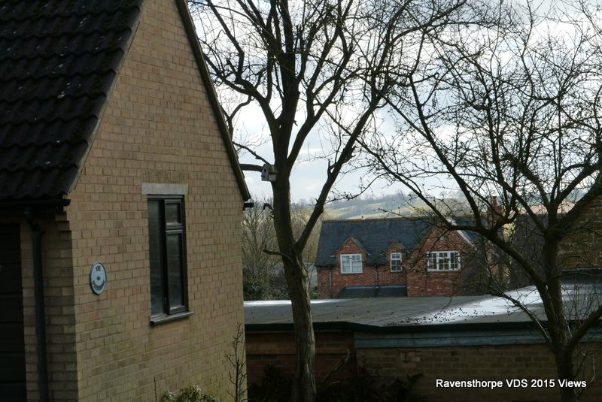
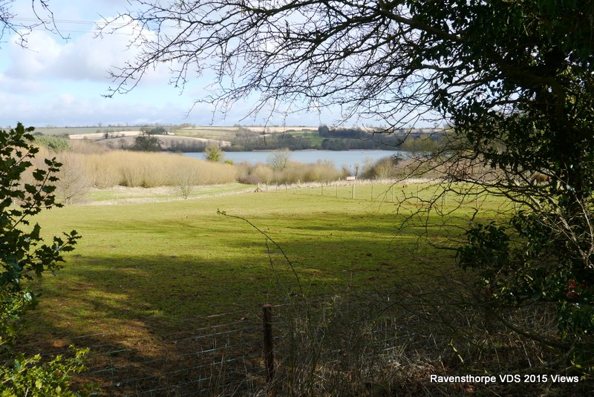
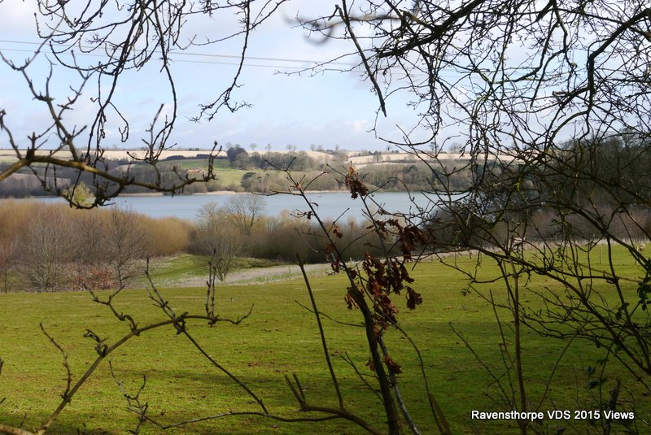

Slide 28
Thanks to all the members of the VDS Review Group
and to the Parish Council for their support.
More information on the village website
http://www.ravensthorpe.me.uk/village-design-statement/

